Slide 1
Data Mining:
Characterization

Slide 2
Concept Description: Characterization and Comparison
What is concept description?
Data generalization and summarization-based characterization
Analytical characterization: Analysis of attribute relevance
Mining class comparisons: Discriminating between different classes
Mining descriptive statistical measures in large databases
Summary

Slide 3
What is Concept Description?
Descriptive vs. predictive data mining
  Descriptive mining: describes concepts or task-relevant data sets in concise, summarative, informative, discriminative forms
  Predictive mining: Based on data and analysis, constructs models for the database, and predicts the trend and properties of unknown data
Concept description:
  Characterization: provides a concise and succinct summarization of the given collection of data
  Comparison: provides descriptions comparing two or more collections of data

Slide 4
Concept Description: Characterization and Comparison
What is concept description?
Data generalization and summarization-based characterization
Analytical characterization: Analysis of attribute relevance
Mining class comparisons: Discriminating between different classes
Mining descriptive statistical measures in large databases
Summary

Slide 5
Data Generalization and Summarization-based Characterization
Data generalization
  A process which abstracts a large set of task-relevant data in a database from a low conceptual levels to higher ones.
1
2
3
4
Conceptual levels
5

Slide 6
Attribute-Oriented Induction
Proposed in 1989 (KDD ‘89 workshop)
Not confined to categorical data nor particular measures.
How it is done?
  Collect the task-relevant data( initial relation) using a relational database query
  Perform generalization by attribute removal or attribute generalization.
  Apply aggregation by merging identical, generalized tuples and accumulating their respective counts.
  Interactive presentation with users.

Slide 7
Basic Principles of Attribute-Oriented Induction
Data focusing: task-relevant data, including dimensions, and the result is the initial relation.
Attribute-removal: remove attribute A if there is a large set of distinct values for A but (1) there is no generalization operator on A, or (2) A’s higher level concepts are expressed in terms of other attributes.
Attribute-generalization: If there is a large set of distinct values for A, and there exists a set of generalization operators on A, then select an operator and generalize A.
Attribute-threshold control: typical 2-8, specified/default.
Generalized relation threshold control: control the final relation/rule size.

Slide 8
Example
Describe general characteristics of graduate students in the Big-University database
  use Big_University_DB
  mine characteristics as “Science_Students”
  in relevance to name, gender, major, birth_place, birth_date, residence, phone#, gpa
  from student
  where status in “graduate”
Corresponding SQL statement:
  Select name, gender, major, birth_place, birth_date, residence, phone#, gpa
  from student
  where status in {“Msc”, “MBA”, “PhD” }

Slide 9



Class Characterization: An Example
Initial Relation
Prime Generalized Relation

Slide 10
Concept Description: Characterization and Comparison
What is concept description?
Data generalization and summarization-based characterization
Analytical characterization: Analysis of attribute relevance
Mining class comparisons: Discriminating between different classes
Mining descriptive statistical measures in large databases
Summary

Slide 11
Attribute Relevance Analysis
Why?
  Which dimensions should be included?
  How high level of generalization?
  Automatic vs. interactive
  Reduce # attributes; easy to understand patterns
What?
  statistical method for preprocessing data
    filter out irrelevant or weakly relevant attributes
    retain or rank the relevant attributes
  relevance related to dimensions and levels
  analytical characterization, analytical comparison

Slide 12
Attribute relevance analysis (cont’d)
How?
  Data Collection
  Analytical Generalization
    Use information gain analysis (e.g., entropy or other measures) to identify highly relevant dimensions and levels.
  Relevance Analysis
    Sort and select the most relevant dimensions and levels.
  Attribute-oriented Induction for class description
    On selected dimension/level
  OLAP operations (e.g. drilling, slicing) on relevance rules

Slide 13
Relevance Measures
Quantitative relevance measure determines the classifying power of an attribute within a set of data.
Methods
  information gain (ID3)
  gain ratio (C4.5)
  χ² contingency table statistics
  uncertainty coefficient

Slide 14
Information-Theoretic Approach
Decision tree
  each internal node tests an attribute
  each branch corresponds to attribute value
  each leaf node assigns a classification
ID3 algorithm
  build decision tree based on training objects with known class labels to classify testing objects
  rank attributes with information gain measure
  minimal height
    the least number of tests to classify an object
See example

Slide 15
Top-Down Induction of Decision Tree
Attributes = {Outlook, Temperature, Humidity, Wind}
PlayTennis = {yes, no}
Outlook
sunny
rain
overcast
Humidity
Wind
yes
high
normal
strong
weak
no
yes
no
yes

Slide 16
Example: Analytical Characterization
Task
  Mine general characteristics describing graduate students using analytical characterization
Given
  attributes name, gender, major, birth_place, birth_date, phone#, and gpa
  Gen(a_{i}) = concept hierarchies on a_{i}
  U_{i} = attribute analytical thresholds for a_{i}
  T_{i} = attribute generalization thresholds for a_{i}
  R = attribute relevance threshold

Slide 17
Example: Analytical Characterization (cont’d)
1. Data collection
  target class: graduate student
  contrasting class: undergraduate student
2. Analytical generalization using U_{i}
  attribute removal
    remove name and phone#
  attribute generalization
    generalize major, birth_place, birth_date and gpa
    accumulate counts
  candidate relation: gender, major, birth_country, age_range and gpa

Slide 18
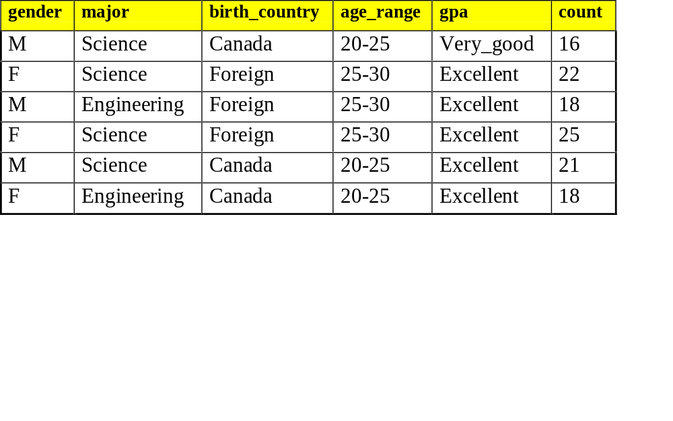
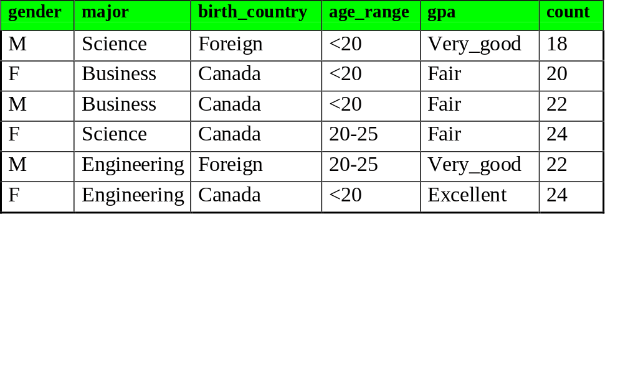
Example: Analytical characterization (2)
Candidate relation for Target class: Graduate students (Σ=120)
Candidate relation for Contrasting class: Undergraduate students (Σ=130)

Slide 19
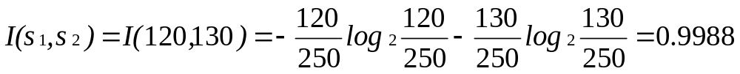
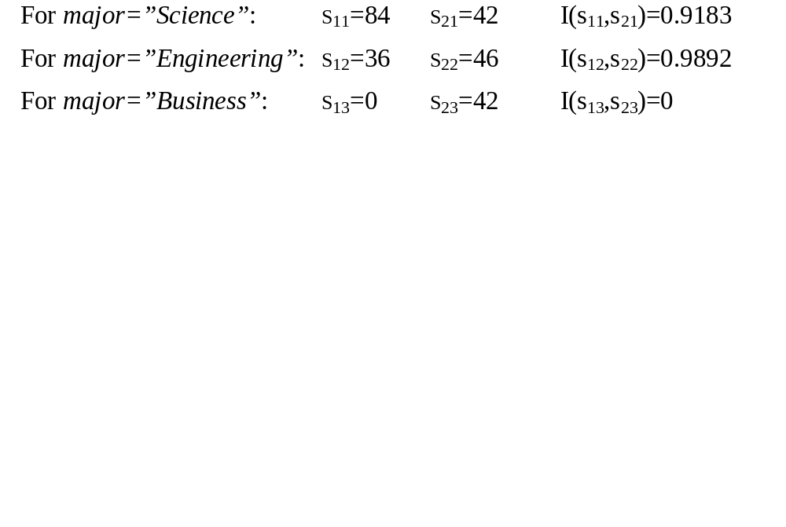
Example: Analytical characterization (3)
3. Relevance analysis
  Calculate expected info required to classify an arbitrary tuple
  Calculate entropy of each attribute: e.g. major
Number of grad students in “Science”
Number of undergrad students in “Science”

Slide 20
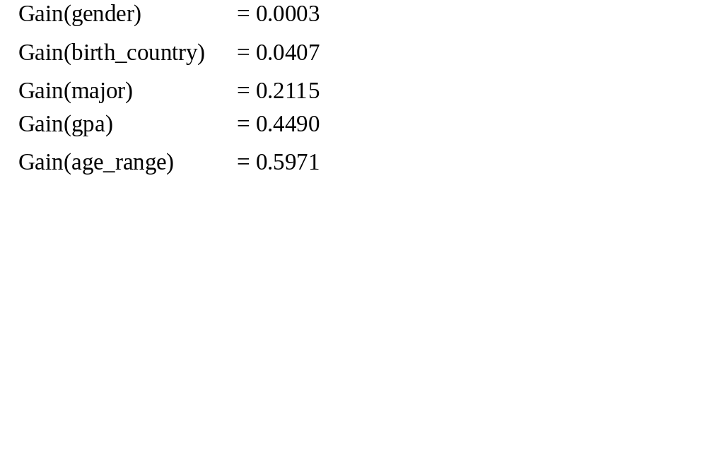
Example: Analytical Characterization (4)
Calculate expected info required to classify a given sample if S is partitioned according to the attribute
Calculate information gain for each attribute
  Information gain for all attributes

Slide 21
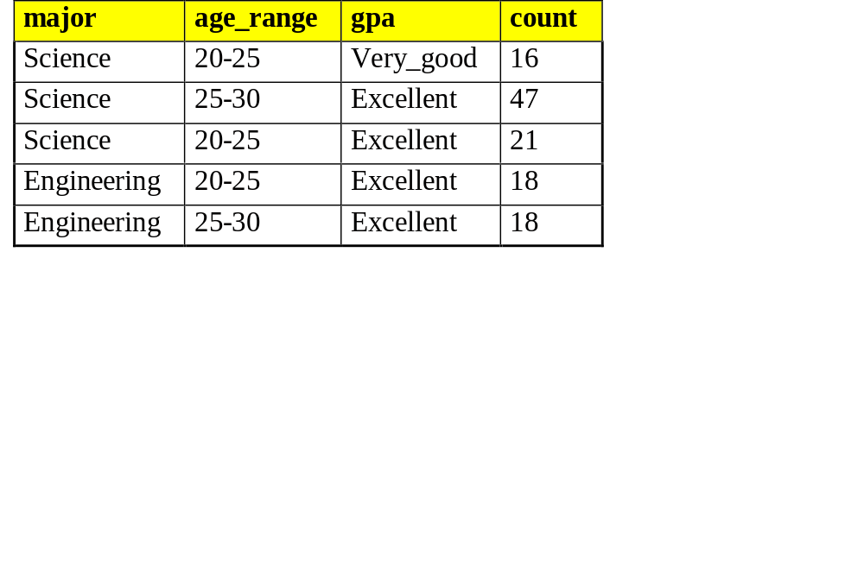
Example: Analytical characterization (5)
4. Initial working relation (W₀) derivation
  R = 0.1
  remove irrelevant/weakly relevant attributes from candidate relation => drop gender, birth_country
  remove contrasting class candidate relation
5. Perform attribute-oriented induction on W₀ using T_{i}
Initial target class working relation W₀: Graduate students

Slide 22
Concept Description: Characterization and Comparison
What is concept description?
Data generalization and summarization-based characterization
Analytical characterization: Analysis of attribute relevance
Mining class comparisons: Discriminating between different classes
Mining descriptive statistical measures in large databases
Summary

Slide 23
Mining Class Comparisons
Comparison: Comparing two or more classes.
Method:
  Partition the set of relevant data into the target class and the contrasting class(es)
  Generalize both classes to the same high level concepts
  Compare tuples with the same high level descriptions
  Present for every tuple its description and two measures:
    support - distribution within single class
    comparison - distribution between classes
  Highlight the tuples with strong discriminant features
Relevance Analysis:
  Find attributes (features) which best distinguish different classes.

Slide 24
Example: Analytical comparison
Task
  Compare graduate and undergraduate students using discriminant rule.
  DMQL query
use Big_University_DB
mine comparison as “grad_vs_undergrad_students”
in relevance to name, gender, major, birth_place, birth_date, residence, phone#, gpa
for “graduate_students”
where status in “graduate”
versus “undergraduate_students”
where status in “undergraduate”
analyze count%
from student

Slide 25
Example: Analytical comparison (2)
Given
  attributes name, gender, major, birth_place, birth_date, residence, phone# and gpa
  Gen(a_{i}) = concept hierarchies on attributes a_{i}
  U_{i} = attribute analytical thresholds for attributes a_{i}
  T_{i} = attribute generalization thresholds for attributes a_{i}
  R = attribute relevance threshold

Slide 26
Example: Analytical comparison (3)
1. Data collection
  target and contrasting classes
2. Attribute relevance analysis
  remove attributes name, gender, major, phone#
3. Synchronous generalization
  controlled by user-specified dimension thresholds
  prime target and contrasting class(es) relations/cuboids

Slide 27
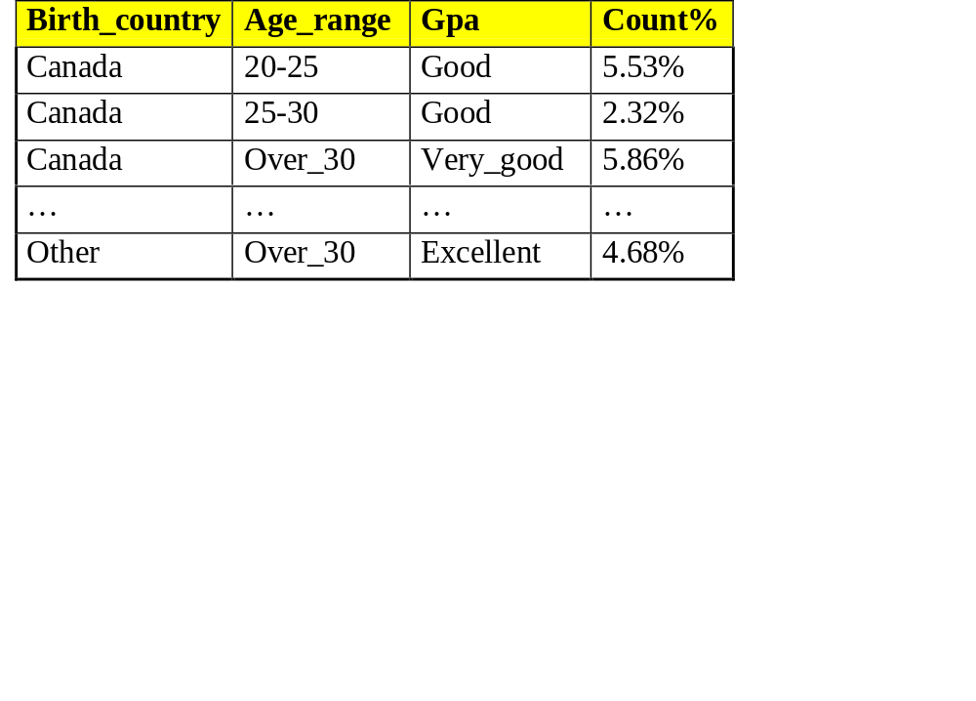
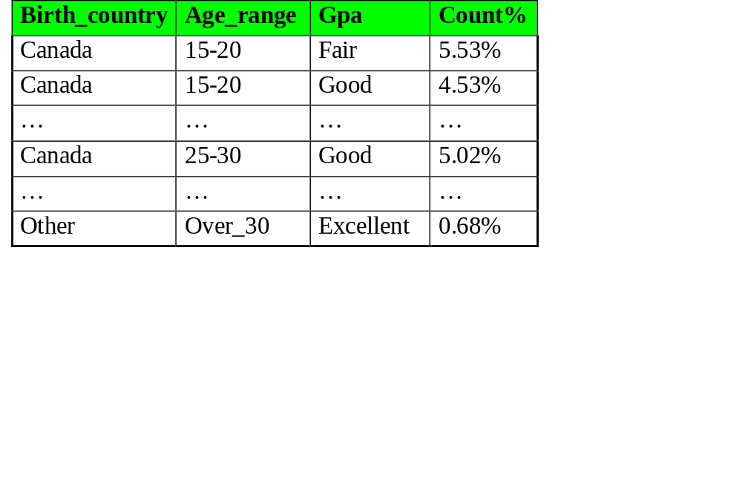
Example: Analytical comparison (4)
Prime generalized relation for the target class: Graduate students
Prime generalized relation for the contrasting class: Undergraduate students

Slide 28
Example: Analytical comparison (5)
4. Drill down, roll up and other OLAP operations on target and contrasting classes to adjust levels of abstractions of resulting description
5. Presentation
  as generalized relations, crosstabs, bar charts, pie charts, or rules
  contrasting measures to reflect comparison between target and contrasting classes
    e.g. count%

Slide 29
Concept Description: Characterization and Comparison
What is concept description?
Data generalization and summarization-based characterization
Analytical characterization: Analysis of attribute relevance
Mining class comparisons: Discriminating between different classes
Mining descriptive statistical measures in large databases
Summary

Slide 30
Mining Data Dispersion Characteristics
Motivation
  To better understand the data: central tendency, variation and spread
Data dispersion characteristics
  median, max, min, quantiles, outliers, variance, etc.
Numerical dimensions correspond to sorted intervals
  Data dispersion: analyzed with multiple granularities of precision
  Boxplot or quantile analysis on sorted intervals
Dispersion analysis on computed measures
  Folding measures into numerical dimensions
  Boxplot or quantile analysis on the transformed cube

Slide 31
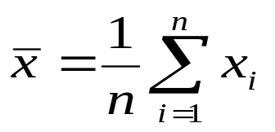

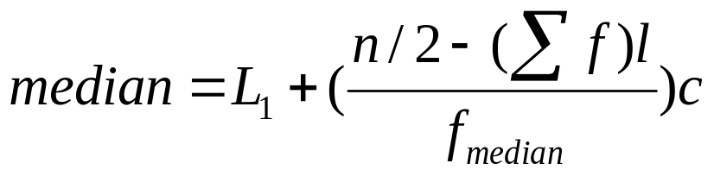
Measuring the Central Tendency
Mean
  Weighted arithmetic mean
Median: A holistic measure
  Middle value if odd number of values, or average of the middle two values otherwise
  estimated by interpolation
Mode
  Value that occurs most frequently in the data
  Unimodal, bimodal, trimodal
  Empirical formula:

Slide 32
Measuring the Dispersion of Data
Quartiles, outliers and boxplots
  Quartiles: Q₁ (25th percentile), Q₃ (75th percentile)
  Inter-quartile range: IQR = Q₃ – Q₁
  Five number summary: min, Q₁, M, Q₃, max
  Boxplot: ends of the box are the quartiles, median is marked, whiskers, and plot outlier individually
  Outlier: usually, a value higher/lower than 1.5 x IQR
Variance and standard deviation
  Variance s²: (algebraic, scalable computation)
  Standard deviation s is the square root of variance s²

Slide 33
Boxplot Analysis
Five-number summary of a distribution:
  Minimum, Q1, M, Q3, Maximum
Boxplot
  Data is represented with a box
  The ends of the box are at the first and third quartiles, i.e., the height of the box is IRQ
  The median is marked by a line within the box
  Whiskers: two lines outside the box extend to Minimum and Maximum

Slide 34

A Boxplot
A boxplot

Slide 35
Concept Description: Characterization and Comparison
What is concept description?
Data generalization and summarization-based characterization
Analytical characterization: Analysis of attribute relevance
Mining class comparisons: Discriminating between different classes
Mining descriptive statistical measures in large databases
Summary

Slide 36
Summary
Concept description: characterization and discrimination
OLAP-based vs. attribute-oriented induction
Efficient implementation of AOI
Analytical characterization and comparison
Mining descriptive statistical measures in large databases
Discussion
  Incremental and parallel mining of description
  Descriptive mining of complex types of data

Slide 37
References
Y. Cai, N. Cercone, and J. Han. Attribute-oriented induction in relational databases. In G. Piatetsky-Shapiro and W. J. Frawley, editors, Knowledge Discovery in Databases, pages 213-228. AAAI/MIT Press, 1991.
S. Chaudhuri and U. Dayal. An overview of data warehousing and OLAP technology. ACM SIGMOD Record, 26:65-74, 1997
C. Carter and H. Hamilton. Efficient attribute-oriented generalization for knowledge discovery from large databases. IEEE Trans. Knowledge and Data Engineering, 10:193-208, 1998.
W. Cleveland. Visualizing Data. Hobart Press, Summit NJ, 1993.
J. L. Devore. Probability and Statistics for Engineering and the Science, 4th ed. Duxbury Press, 1995.
T. G. Dietterich and R. S. Michalski. A comparative review of selected methods for learning from examples. In Michalski et al., editor, Machine Learning: An Artificial Intelligence Approach, Vol. 1, pages 41-82. Morgan Kaufmann, 1983.
J. Gray, S. Chaudhuri, A. Bosworth, A. Layman, D. Reichart, M. Venkatrao, F. Pellow, and H. Pirahesh. Data cube: A relational aggregation operator generalizing group-by, cross-tab and sub-totals. Data Mining and Knowledge Discovery, 1:29-54, 1997.
J. Han, Y. Cai, and N. Cercone. Data-driven discovery of quantitative rules in relational databases. IEEE Trans. Knowledge and Data Engineering, 5:29-40, 1993.

Slide 38
References (cont.)
J. Han and Y. Fu. Exploration of the power of attribute-oriented induction in data mining. In U.M. Fayyad, G. Piatetsky-Shapiro, P. Smyth, and R. Uthurusamy, editors, Advances in Knowledge Discovery and Data Mining, pages 399-421. AAAI/MIT Press, 1996.
R. A. Johnson and D. A. Wichern. Applied Multivariate Statistical Analysis, 3rd ed. Prentice Hall, 1992.
E. Knorr and R. Ng. Algorithms for mining distance-based outliers in large datasets. VLDB'98, New York, NY, Aug. 1998.
H. Liu and H. Motoda. Feature Selection for Knowledge Discovery and Data Mining. Kluwer Academic Publishers, 1998.
R. S. Michalski. A theory and methodology of inductive learning. In Michalski et al., editor, Machine Learning: An Artificial Intelligence Approach, Vol. 1, Morgan Kaufmann, 1983.
T. M. Mitchell. Version spaces: A candidate elimination approach to rule learning. IJCAI'97, Cambridge, MA.
T. M. Mitchell. Generalization as search. Artificial Intelligence, 18:203-226, 1982.
T. M. Mitchell. Machine Learning. McGraw Hill, 1997.
J. R. Quinlan. Induction of decision trees. Machine Learning, 1:81-106, 1986.
D. Subramanian and J. Feigenbaum. Factorization in experiment generation. AAAI'86, Philadelphia, PA, Aug. 1986.

